Slide 1
Topic Model for 20 NG Dataset
using Clustering Algorithms
Aditya Singhal Hasib Kamal
1154832 1155165
Big Data Project Instructor: Prof. Quazi Rahman

Slide 2
What is Clustering?
The method of identifying similar groups of data in a dataset is called clustering.
It is unsupervised learning.
Finds the underlying patterns in data.
Notes:
The method of identifying similar groups of data in a dataset is called clustering.
It is unsupervised learning.
Works by finding the underlying patterns in data when there are no class labels.

Slide 3
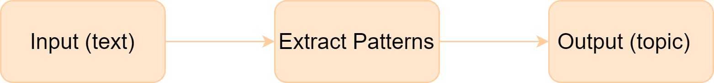
What is topic modeling?
No need to read complete text, the predicted topic can give a context.
Notes:
Topic modeling processes a text (input) and automatically generates an appropriate topic (output) that is extracted through patterns found in the text corpus.
With this, we can tell what the context of the text is by only reading its predicted topic, rather than reading the whole text, thus saving time when seeking information online.

Slide 4
Why perform topic modeling using clustering?
To understand the effectiveness of various clustering-based ML models on news websites.
To aid experts to prioritize areas of study for tasks like controlling specific misinformation topics or analyzing public engagements on particular topics.
Notes:
We plan to evaluate several techniques for document embeddings and clustering on the 20 NG dataset.
The results obtained from this project can help in understanding the effectiveness of various clustering-based ML models on news websites having large amounts of unrelated news articles.
This can aid health experts to prioritize areas of study for tasks like controlling specific misinformation topics or analyzing public engagements on particular topics.

Slide 5
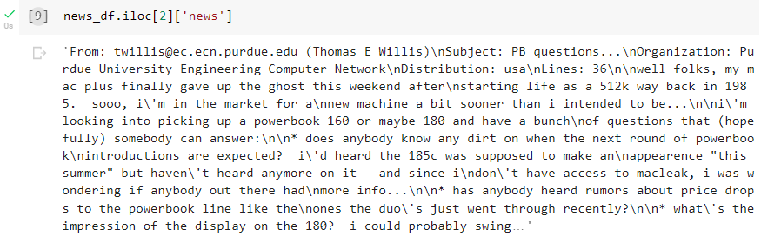
Dataset (20 Newsgroup)
Instances: 11,314
Classes: 20
Feature columns: Text_id, Text, and Category
Dataset lin
Dataset: https://www.kaggle.com/crawford/20-newsgroups
Notes:
The dataset we are using is called the 20 Newsgroups dataset. It has a collection of 11,314 newsgroup documents (instances), divided nearly evenly across 20 different topics. The dataset consists of three feature columns: Text_id, Text, and Category
Average length of an instance is approx 2,000 characters

Slide 6
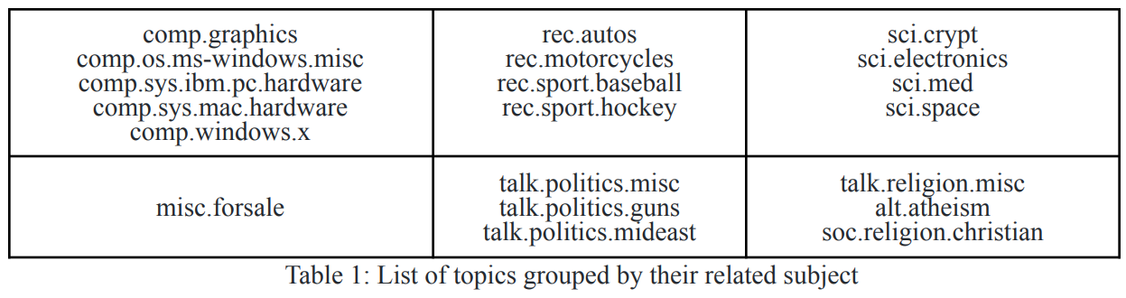
Dataset split: Training - Testing in 80:20
Notes:
The table shows a list of the 20 topics, separated according to the related subject
Some of the instances are very closely related to each other (e.g. comp.sys.ibm.pc.hardware / comp.sys.mac.hardware), while others are highly unrelated (e.g misc.forsale/ soc.religion.christian)

Slide 7
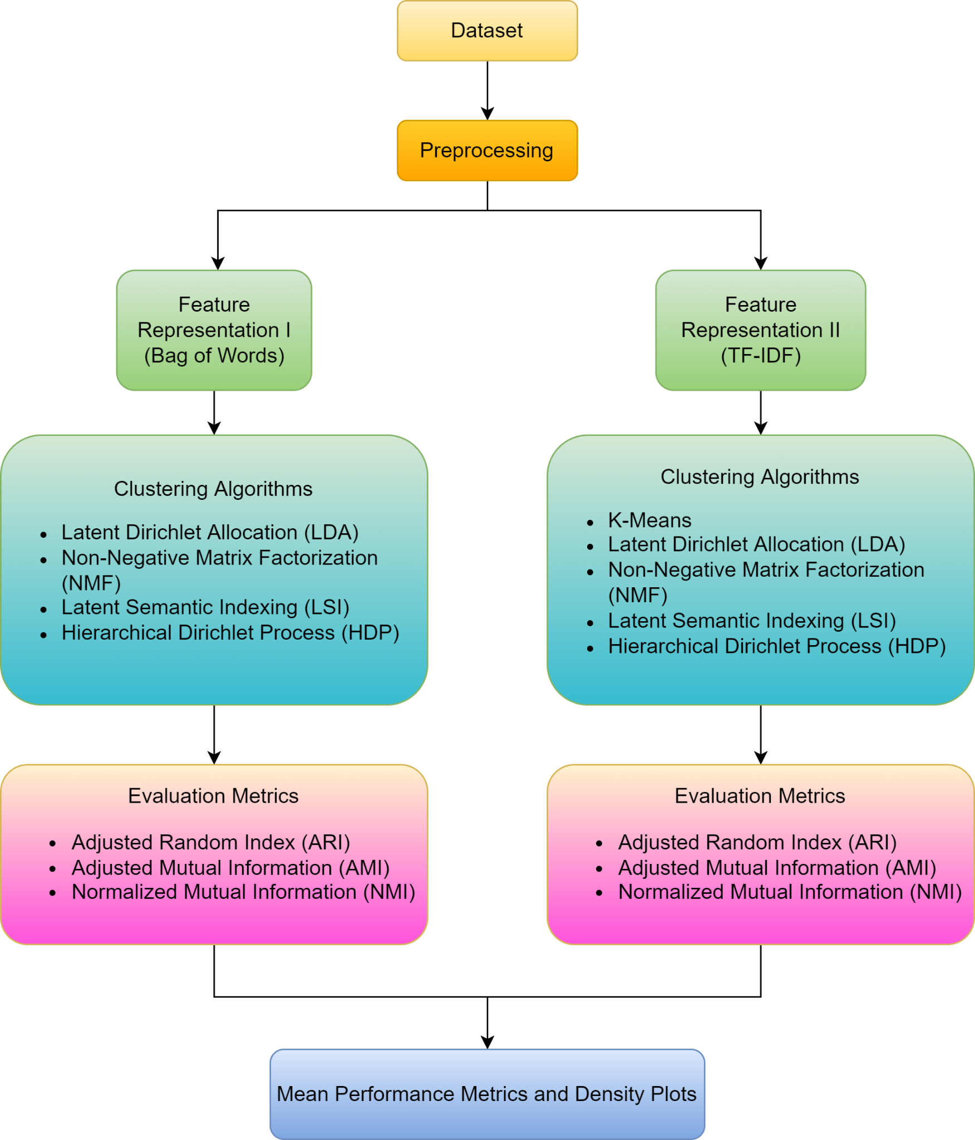
Flowchart outlining methodology

Slide 8
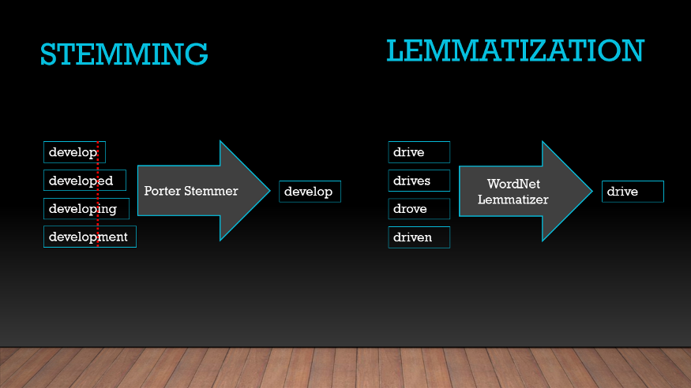
Pre-processing
We implement the following pre-processing steps:
❖ Non-alphabet removal: “!”, “2”, “\n”, “ “
❖ Tokenization: “Big data” -> “Big”, “data”
❖ Stop word removal: “the”, “a”, “an”
❖ Stemming & Lemmatization
Image courtesy:Kaggle
Notes:
Non-alphabet removal: (punctuation, numbers, new-line characters and extra-spaces)
Tokenization is a way of separating a piece of text into smaller units called tokens with “space” as delimiter
Stop word removal using nltk library to remove words which don’t add any meaning

Slide 9
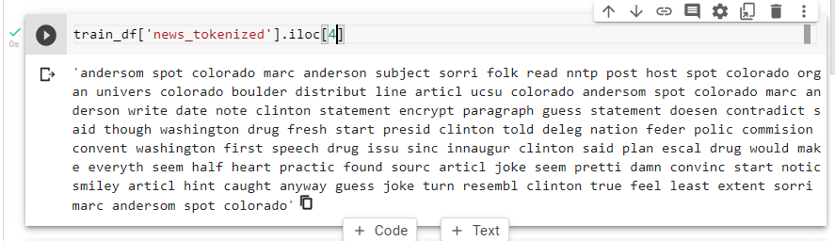
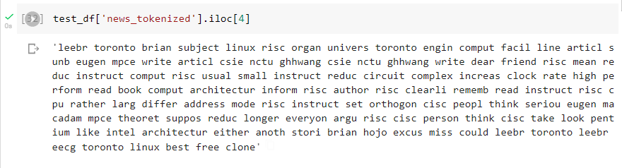

Slide 10
Feature representation 1
❖ Bag of words (BoW)
Sentence 1: Health experts read health news.
Sentence 2: Health experts read sports news.
Output- Health: 3, experts: 2, read: 2, news: 2, sports: 1
(Hypothetical Example!)
Notes:
we use two different feature representations:
❖ Bag of words (BoW) which describes the occurrence of word

Slide 11
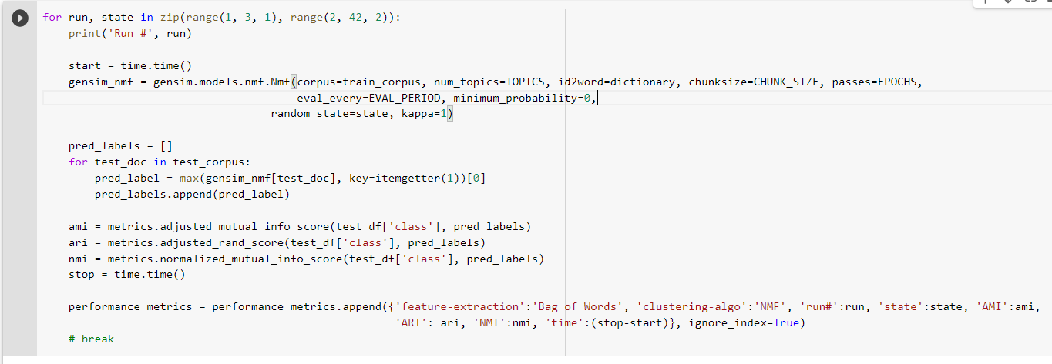
Clustering algorithm (I)
❖ Non-Negative Matrix Factorization (NMF)

Slide 12
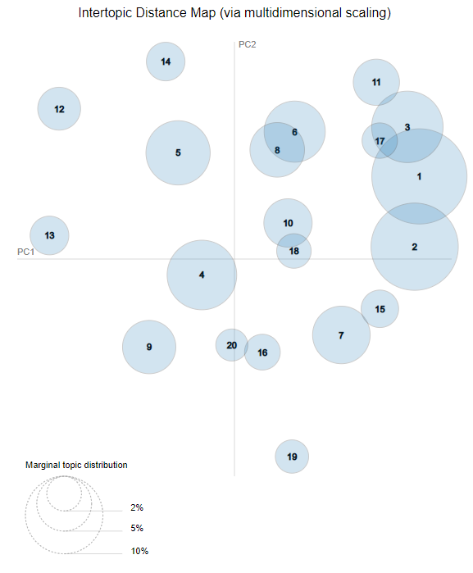
Clustering
algorithm (II)
❖ Latent Dirichlet
Allocation (LDA)

Slide 13
Clustering algorithms (II, III & IV)
❖ Latent Semantic Indexing (LSI)
❖ Hierarchical Dirichlet process (HDP)

Slide 14
Evaluation Metrics
❖ Adjusted Random Index (ARI)
❖ Adjusted Mutual Information (AMI)
❖ Normalized Mutual Information (NMI)
All vary between 0 and 1
Notes:
To evaluate the models, we’ll be using: ❖ Adjusted Random Index (ARI) ❖ Adjusted Mutual Information (AMI) ❖ Normalized Mutual Information (NMI)

Slide 15
Feature- extraction | Clustering- algo | run# | state | AMI | ARI | NMI | time
Bag of Words | NMF | 1 | 2 | 0.238223 | 0.041038 | 0.264692 | 200.9551
Bag of Words | NMF | 2 | 4 | 0.278979 | 0.069524 | 0.302633 | 201.3139
Bag of Words | LDA | 1 | 2 | 0.454268 | 0.280901 | 0.470963 | 1646.696
Bag of Words | LSI | 1 | 2 | 0.083412 | 0.004474 | 0.103052 | 7.678815
Bag of Words | LSI | 2 | 4 | 0.083412 | 0.004474 | 0.103052 | 7.454431
Bag of Words | HDP | 1 | 2 | 0.083412 | 0.004474 | 0.103052 | 71.59744
Bag of Words | HDP | 2 | 4 | 0.083412 | 0.004474 | 0.103052 | 63.1918
Table 2: Performance Metrics using BoW as Feature extraction

Slide 16
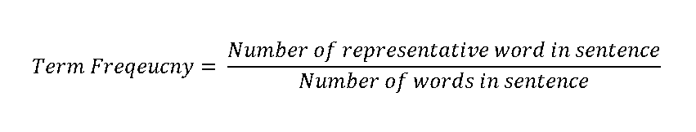
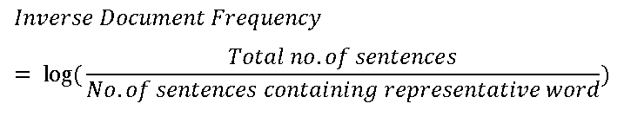
Feature Representation 2
❖ Term Frequency-Inverse Document Frequency (TF-IDF)
Notes:
TF-IDF reflectS how important a word is to a document

Slide 17
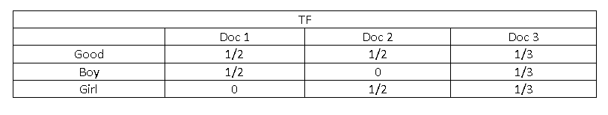
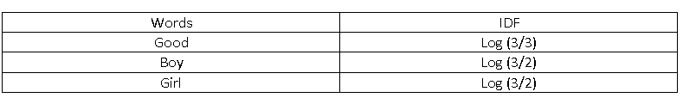
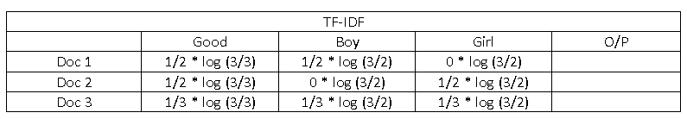
TF-IDF (Contd.)
Doc 1 : Good Boy
Doc 2 : Good Girl
Doc 3 : Good Boy Girl

Slide 18
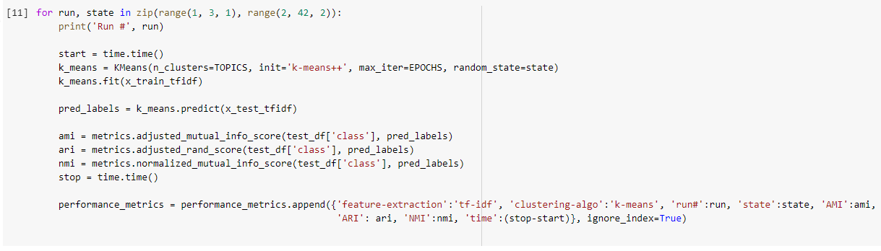
Clustering algorithm (I)
❖ K-Means

Slide 19
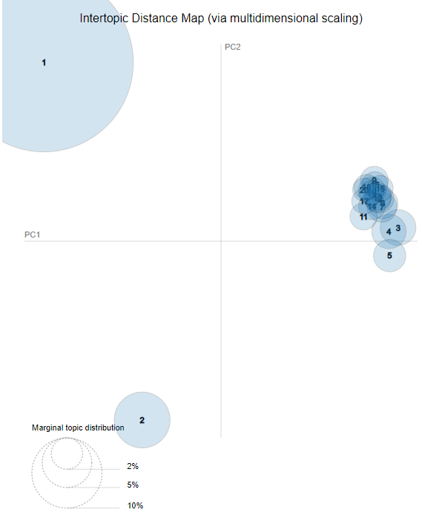
Clustering
algorithm (II)
❖ Latent Dirichlet
Allocation (LDA)

Slide 20
Clustering algorithms (III to V)
❖ Latent Semantic Indexing (LSI)
❖ Non-Negative Matrix Factorization (NMF)
❖ Hierarchical Dirichlet process (HDP)
Notes:
We implement five clustering techniques: ❖ K-Means ❖ (LDA) ❖ (LSI) ❖ (NMF) ❖ HDP

Slide 21
Feature- extraction | Clustering- algo | run# | state | AMI | ARI | NMI | time
tf-idf | k-means | 1 | 2 | 0.432945 | 0.152264 | 0.451518 | 24.14566
tf-idf | k-means | 2 | 4 | 0.395782 | 0.113128 | 0.415687 | 13.98087
tf-idf | NMF | 1 | 2 | 0.467219 | 0.298985 | 0.482907 | 142.3671
tf-idf | NMF | 2 | 4 | 0.459631 | 0.290203 | 0.475536 | 130.4342
tf-idf | LDA | 1 | 2 | 0.025723 | 0.000662 | 0.054395 | 1081.584
Bag of Words | LSI | 1 | 2 | 0.089351 | 0.004145 | 0.120342 | 17.14844
Bag of Words | LSI | 2 | 4 | 0.079562 | 0.00329 | 0.109348 | 15.26166
Bag of Words | HDP | 1 | 2 | 0.079562 | 0.00329 | 0.109348 | 90.91767
Bag of Words | HDP | 2 | 4 | 0.079562 | 0.00329 | 0.109348 | 86.95522
Table 3: Performance Metrics using TF-IDF as Feature extraction

Slide 22
Mean Performance Metrics
 | clustering- algo | ARI | AMI | NMI | time | embedding
0 | HDP | 0.002613 | 0.067591 | 0.095179 | 85.536283 | TF-IDF
1 | LDA | 0.000662 | 0.025723 | 0.054395 | 1081.584181 | TF-IDF
2 | LSI | 0.002488 | 0.064053 | 0.090843 | 13.654636 | TF-IDF
3 | NMF | 0.294594 | 0.463425 | 0.479222 | 136.400638 | TF-IDF
4 | k-means | 0.132696 | 0.414364 | 0.433602 | 19.063267 | TF-IDF
5 | HDP | 0.004474 | 0.083412 | 0.103052 | 67.394618 | Bag Of Words
6 | LDA | 0.280901 | 0.454268 | 0.470963 | 1646.696481 | Bag Of Words
7 | LSI | 0.004474 | 0.083412 | 0.103052 | 7.566623 | Bag Of Words
8 | NMF | 0.055281 | 0.258601 | 0.283663 | 201.134503 | Bag Of Word

Slide 23
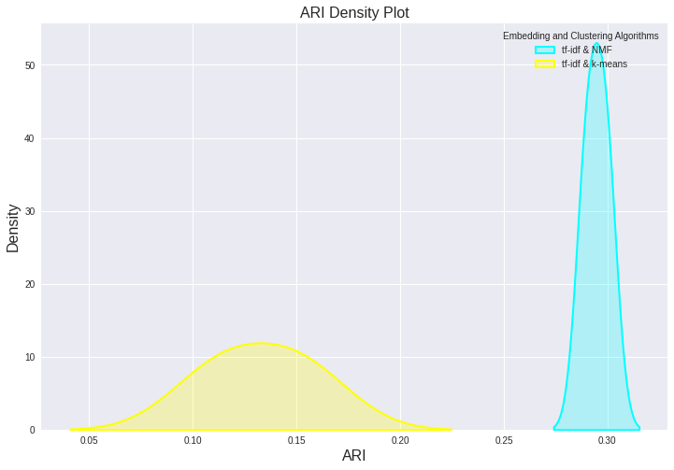

Slide 24
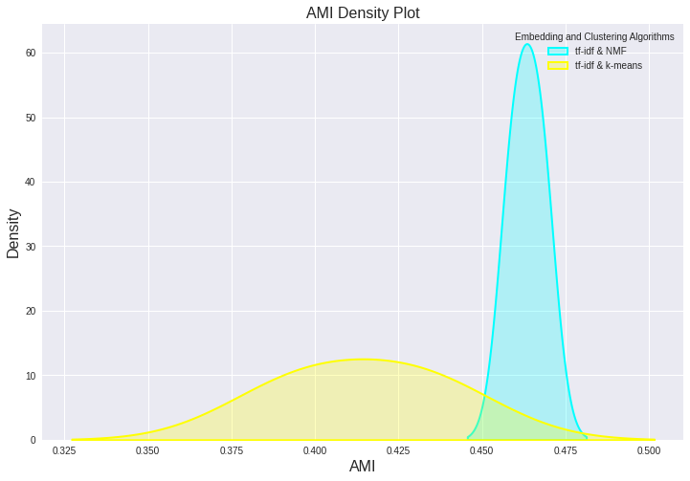

Slide 25


Slide 26
Conclusion
Overall, clustering algorithm NMF with feature extraction (word embedding) method TF-IDF outperforms all others.
LDA takes the longest time, while LSI is the fastest.

Slide 27
Members’ Contributions
Aditya Singhal: Problem statement, dataset, Feature representation 1 and its clustering algorithms.
Hasib Kamal: Feature representation 2 and its clustering algorithms, density plots.

Slide 28
Thank You!

